Slide 1

Otto Summary
By, Justin Gauthier
Notes:
Thanks to everyone coming.
In the last 2 and a half months I have been working on a web application which I called Otto Summary.
The Otto automation application is an automation system built by my mentor Chris and other members of the dev/MRQA team to run regression tests against pre-existing bugs from previous releases.

Slide 2
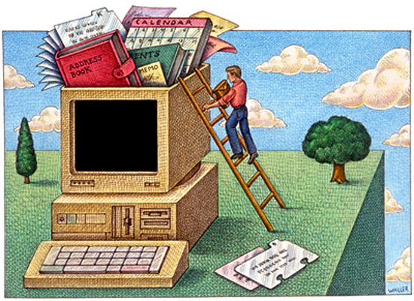
Targeted Issues
Ottomation produces a lot of information
Inconvenience of information
Management
Historical information
Abundance of logs
Notes:
Ottomation application used for regression testing
Less manual testing
Faster and allows people to do something else while tests are being automatically run
GUI of Ottomation program
More convenient to pull up information on web browser
On a management perspective it was difficult to keep track of who is doing what and what is actually being run
No way to assign testing
Only provides information on the tests that are currently being run
Amount of logs Ottomation creates and no way to sort through those logs for specific information needed

Slide 3
How did we overcome these conflicts?
Notes:
How did we overcome these problems?
Outlined are the steps that I took to complete the web app as well as solving those conflicts along the way.

Slide 4

Step One
Project outline
Created logical outline
Basic outer layer
Notes:
Looking through the project outline my mentor gave me on the first day gave me rough estimate for about how many sections in this application there are.
I will talk about these sections in detail during the live demo.
I went through and created a logical outline of each section and tried to solve each problem on paper before I started to implement actual code.
I personally like putting everything on paper first because it allows me to go back and take a look at my thought process from yesterday to today for example.
I would come in the next day and look at my notes and have no clue where that idea came from.
Sometimes the logic made absolutely no sense, but the day before it seemed fine.
From there I was then able to create a mental picture of what I wanted the basic outline of the main page to look like.

Slide 5
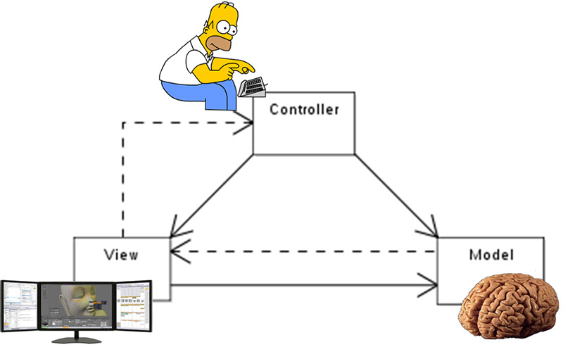
Step Two
Built from the inside out
Basic structure
Notes:
The basic structure I built my project off of are shown in this picture here.
The view, the controller, and the model.
As each picture shows is basically what each part does for the application.
The View is the easiest part of application.
Its simply what the user sees on the screen.
The Controller is the section of the application that grabs all of the input from the user after submission.
In here it then organizes the information provided and goes through specific error checking depending on the situation.
It is then sent to the Model.
The Model is where everything involving the database statements are held.
After the necessary information is taken from the database it then sends the information back to the view for output of the final results.

Slide 6

Step Three
Simple design
Easy to navigate
Notes:
This is the outcome of the basic design structure that I created for the main page.
There are a couple tabs that have sub tabs as well to keep the length of the nav bar to a minimum.
The application is divided into 7 sections which I will explain in detail during the live demo.
Resources In Use, Test Counts, Test Project Status, User and Project Preferences, Log and Report Viewer, and finally the Otto - Documentation

Slide 7

Step Four
Testing
Quality
Assurance
Notes:
This process continued throughout the entire building process.
This is probably the most painful step in my mind.
Story about Java App not working and creating a directory with php and the virtual directory on IIS.
Chris stepping in to help with the Log Viewer script
The testing portion is when I would go through fix bugs that I find throughout coding the project and then once a section is finished I would then try to find potential issues that could be made by user input or other things of that nature.
After I thought I found everything I would have my mentor take a look at it and he would basically tear each section apart to find the bugs that I missed during my testing process.

Slide 8

Step Five
IT WORKS!
Final Implementation
Last minute fixes
Notes:
The final step of the process was setting up the application for final deployment.
My mentor suggested we make another clone to test the deployment of the web app.
There were a couple mishaps along the way but it made the final deployment that much easier.
This is also an example of the testing/QA step. Basically trying to cover every path nothing serious happens during the final deployment.
During that process there were little bugs that needed to be fixed along the way but for the most part it was a quick and easy transition.
It is one of the best feelings when everything is working according to plan and everyone that is using the application approves.

Slide 9

Live Demo
Notes:
What each section does, why are they helpful, how did each section sold the conflicts.
Database population, python script mentor made, what information does it grab.
Conflicts
Amount of information
Location of information
Management
Historical information
Logs

Slide 10

Any Questions?
Notes:
Everything that I learned during this internship could not have been learned in school.
Everything from the environment to any other tasks that might have popped up along the way to delay the final product. Everything that I have learned will only benefit me for years to come.
Thank you and questions

Slide 11
Picture References
http://images.clipartpanda.com/blog-clipart-computer-guy-clip-art.png
http://static1.squarespace.com/static/52e173f1e4b0e369b87ad37a/53ad92b3e4b0d2cc9c8b7ed0/53ad92b4e4b0dcbdb88b719f/1403884215631/Dell-01.png
http://quantumwealth.com/wp-content/uploads/2012/09/Fotolia_44177691_XS.jpg
http://www.coderiddles.com/wp-content/uploads/2013/08/MVC.jpg
http://www.enasha.com/UserFiles/Image/Technology/organizing_computer.jpg
http://www.360logica.com/blog/wp-content/uploads/2015/04/software_tester.jpg
https://pbs.twimg.com/media/B_-v2-tUwAA1vbp.png

